Slide 1
CSE 405
I/O Interfacing
Osama Hosameldeen
Spring 2021
Lecture 3: Software Considerations

Slide 2
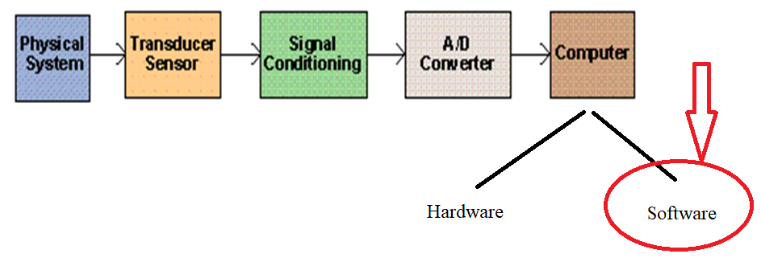
Contents
Requirements of real-time DA&C systems
Systems with more stringent timing requirements
Real-time design considerations
Implementing real-time systems on the PC.
All rights reserved. compiled by Dr. Osama Hosameldeen

Slide 3
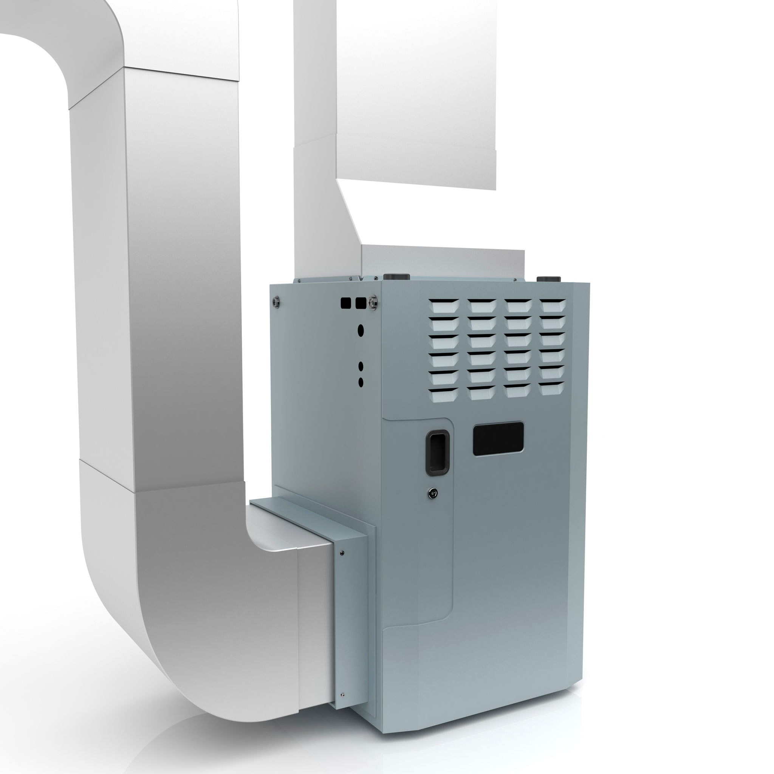
A real-time DA&C system
Is one in which the time taken to read data, process that data and then issue an appropriate response is negligible.
The furnace controller can swing off and on around the mean of the required temperature.
That swinging response time should be limited and reduce to a minimum. Then we can say the furnace system is Real-Time DA&C system.
All rights reserved. compiled by Dr. Osama Hosameldeen

Slide 4
Requirements of real-time
DA&C systems
A number of factors conspire to make the temporal response of the PC somewhat unpredictable
  High speed: throughput rates and response times, PCs are equipped with very powerful processors which are more than adequate for many DA&C tasks. However, the memory and I/O systems, must also be capable of operating at high speed
  Determinism: possible to precisely predict every detail in which the system responds to specific events or conditions. In other words, the times taken to respond to interrupts, perform task switches and execute operating system services etc. are well known and guaranteed
  High resolution timekeeping and pacing facilities: precisely measure elapsed time. Be able to distribute time between I/O peripherals

Slide 5
Requirements of real-time
DA&C systems
  Flexible interfacing capability: interface easily to sensors, actuators and other equipment. Covers PC’s physical interfacing capacity (i.e. the presence of appropriate plugs, sockets and expansion slots), also encompasses means of transferring data in and out of the computer. PCI, ISA buses and DMA and bust mastering
  Ability to model real-world processes: The logical structure of a real-time DA&C system should adequately mirror the processes that are being monitored. This may need specialized RTO real-time OS to avoid some of the pitfalls associated with standard ‘desktop’ operating systems.
  Robustness and reliability: this is a rather obvious requirement, but its importance cannot be overstated

Slide 6
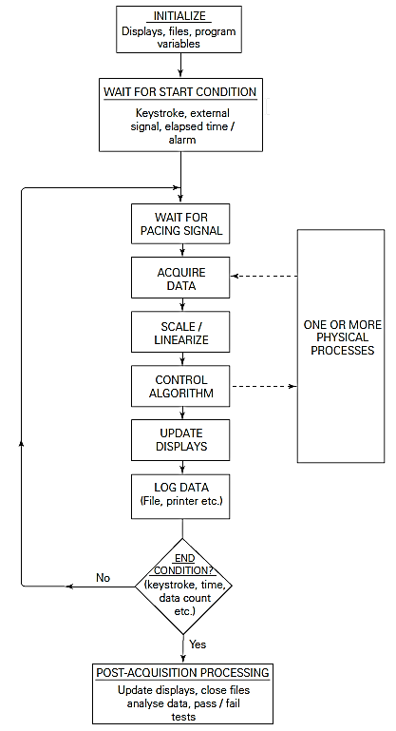
Simple DA&C software scheme
The figure shows a schematic illustration of the structure of a typical DA&C program based on a simple polling loop.
The process, or multiple processes are monitored using the polling loop.
The loop may also include actions such as generating signals to control external apparatus (RHS of graph)
© 2015 ELSIVER, All rights reserved. compiled by Dr. Osama Hosameldeen

Slide 7
Systems with more stringent timing requirements
In the upcoming slides, we discuss the factors that affect real time systems
© 2015 ELSIVER, All rights reserved. compiled by Dr. Osama Hosameldeen

Slide 8
Interrupts
Interrupts are the means by which the system timer, the keyboard and other PC peripherals request the processor’s attention.
The processor responds, as soon as possible, by temporarily suspending execution of the current program and then jumping to a predefined software routine
Because an interrupt handling routine is executed in preference to the main portion of the program, it is considered to have a higher priority than the non-interrupt code.
© 2015 ELSIVER, All rights reserved. compiled by Dr. Osama Hosameldeen

Slide 9
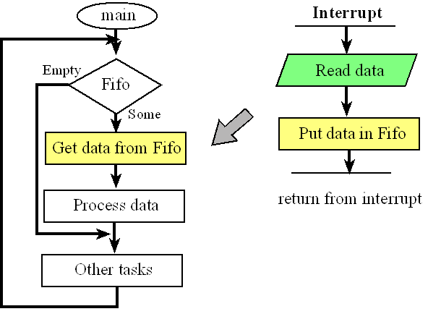
Interrupts
For the system to be real time, we should be able control interrupt re-entrant and interrupt latencies.
More on those two factors in the upcoming slides
Stack=Fifo
© 2015 ELSIVER, All rights reserved. compiled by Dr. Osama Hosameldeen

Slide 10
Interrupts : re-entrant
Software should
preserve all processor registers
refrain from interfering with any hardware devices
Care should be taken when calling any subroutines or operating system services from within the interrupt handler. Multiple invocation (re-entrant) from within interrupt may lead to problems.
DOS is no re-entrant. RTOs are partially re-entrant.
© 2015 ELSIVER, All rights reserved. compiled by Dr. Osama Hosameldeen

Slide 11
Interrupts : Interrupt latencies
The delay between interrupt signal and the time of handling the interrupt, interrupt latency.
The programmer should be able to estimate the maximum latency.
Windows and DOS are non-deterministic, they have very high latency as they can respond to an OS service while handling the interrupt.
RTOs are designed to reduce interrupt latency.
© 2015 ELSIVER, All rights reserved. compiled by Dr. Osama Hosameldeen

Slide 12
Concurrent processing
Processing should be done in parallel (as shown in next slide). For single threaded computers, this can be done by assigning DA to different system. This is done by
Delegating specific real-time tasks to distributed intelligent data-logging or control modules
Dedicated data-acquisition cards, with on-board memory buffers and an intrinsic processing ability
The use of separate multiprocessing computer systems
Multi-tasking, concurrent programming is available in Windows and Linux
© 2015 ELSIVER, All rights reserved. compiled by Dr. Osama Hosameldeen

Slide 13
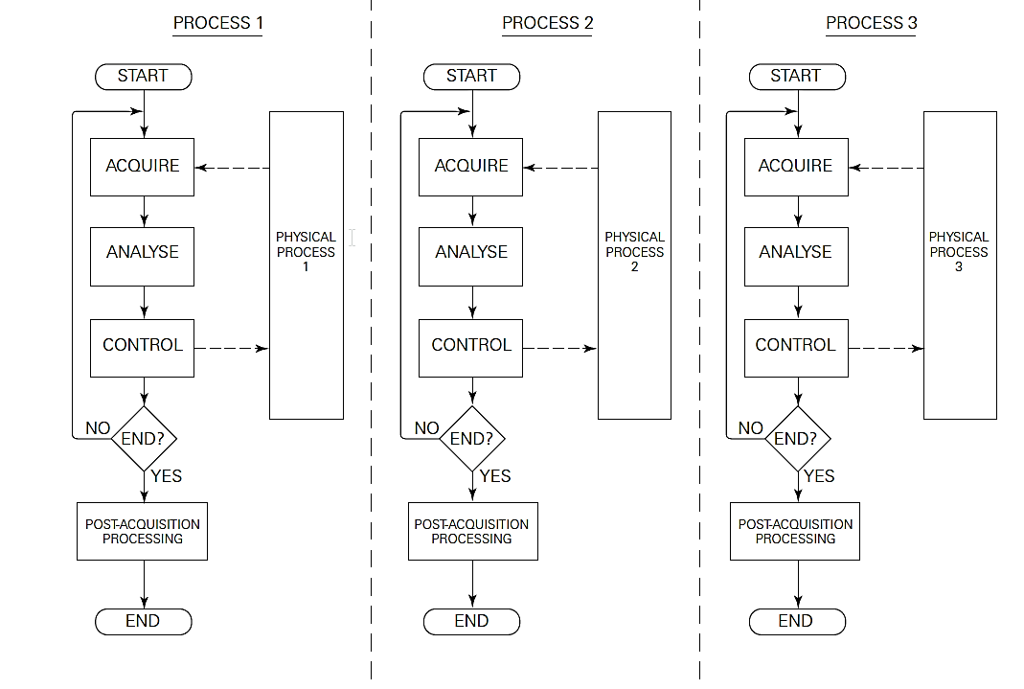
Concurrent processing
Schematic illustration of concurrent monitoring and control of parallel processes

Slide 14
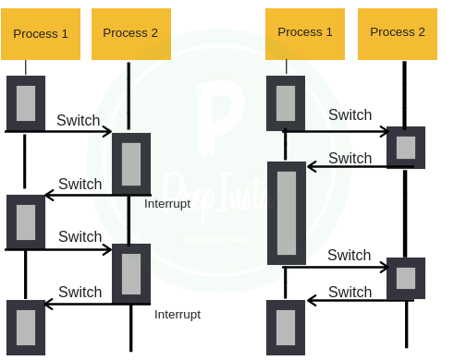
Scheduling
The OS process of allocating execution time to the various tasks is known as scheduling.
In non-pre-emptive scheduling, the operating system will perform a task switch only when it detects that the current task has reached a suitable point.
Pre-emptive scheduling, on the other hand, provides for a fairer division of time between all pending processes
Pre-emptive
Non pre-emptive
© 2015 ELSIVER, All rights reserved. compiled by Dr. Osama Hosameldeen

Slide 15
Task switching, threads and processes
For the system to handle task switching, it should store current state and handle the data of the new task. This is not feasible in real time systems.
Another approach is multi-threading, in which the process can have multiple threads sharing data and code. This is faster than multitasking since less data will be handled and stored for switching between threads.
Windows NT supports multi-threaded processes.
© 2015 ELSIVER, All rights reserved. compiled by Dr. Osama Hosameldeen

Slide 16
Real-time design considerations:
a brief overview
In the upcoming slides, we introduce the fundamentals
of real-time design
© 2015 ELSIVER, All rights reserved. compiled by Dr. Osama Hosameldeen

Slide 17
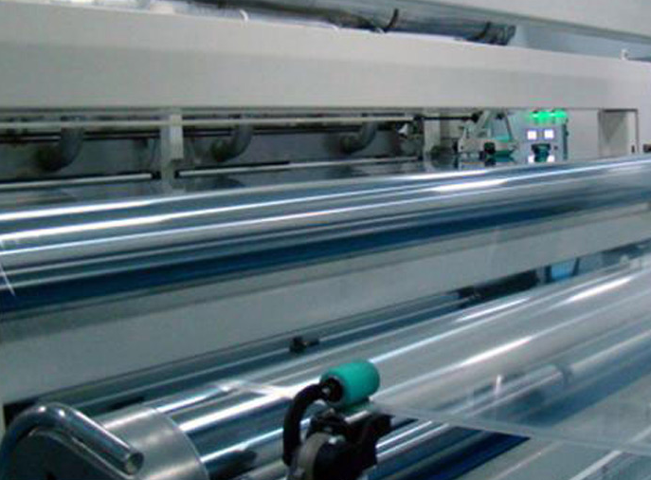
Structure of real-time multitasking programs
Example: the control of a manufacturing process for producing rolled metal or polymer sheet.
One task might be dedicated to monitoring and controlling product thickness.
Another may be assigned to regulating the temperature
Yet another task for periodically transferring thickness, temperature and status information to the display.
See next slide
© 2015 ELSIVER, All rights reserved. compiled by Dr. Osama Hosameldeen

Slide 18
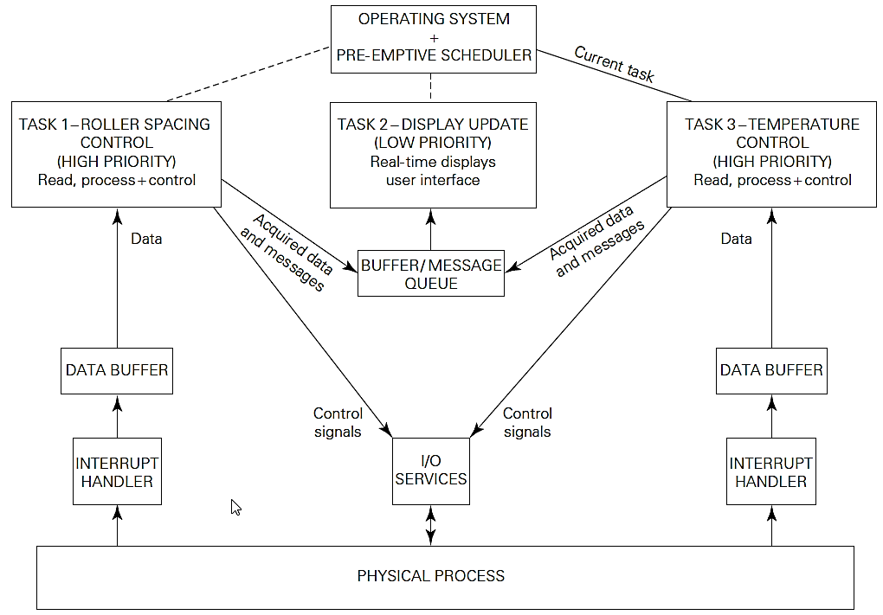
Structure of real-time multitasking programs
© 2015 ELSIVER, All rights reserved. compiled by Dr. Osama Hosameldeen

Slide 19
Accessing shared resources and interprocess communication
Interprocess communication involves accessing a shared resource such as a buffer or message queue that is maintained somewhere in the PC’s memory.
This shared location is called “critical section”, it should be protected using technique called “mutex” or mutual exclusive in which only one task is handling critical section at any time.
Mutex can implemented with semaphores.
© 2015 ELSIVER, All rights reserved. compiled by Dr. Osama Hosameldeen

Slide 20
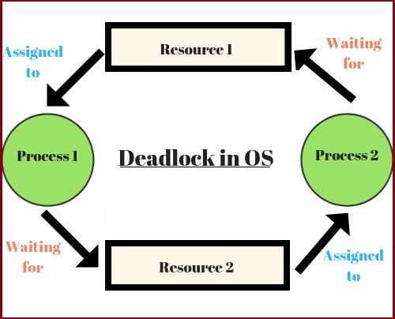
Deadlocks and lockouts
A deadlock occurs when all processes within a system become suspended as a result of each process waiting for another to perform some action.
Great care must be taken to avoid the possibility of deadlocks or lockouts in any real-time system.
© 2015 ELSIVER, All rights reserved. compiled by Dr. Osama Hosameldeen

Slide 21
Priorities
in real-time systems, it is allowing the most important or time-critical tasks to take precedence.
In some systems, priorities can be changed dynamically.
Priority inversion problem, is an OS scenario in which a higher priority process is preempted by a lower priority process. This implies the inversion of the priorities of the two processes.
© 2015 ELSIVER, All rights reserved. compiled by Dr. Osama Hosameldeen

Slide 22
Implementing real-time systems on the PC
In the upcoming slides, will show how OS may be a source of problems in real-time systems.
© 2015 ELSIVER, All rights reserved. compiled by Dr. Osama Hosameldeen

Slide 23
Operating systems
MS-DOS and Microsoft Windows, were not designed specifically for real-time use. Interrupt latencies and re-entrancy can be problematic. See next slide
Non-deterministic OS such as Windows may be used in conjunction with slow software-controlled DA&C hardware.
The use of buffered DA&C cards, hardware triggering, autonomous data loggers or specialized RTOSs increases sampling rate and reduces time.
© 2015 ELSIVER, All rights reserved. compiled by Dr. Osama Hosameldeen

Slide 24
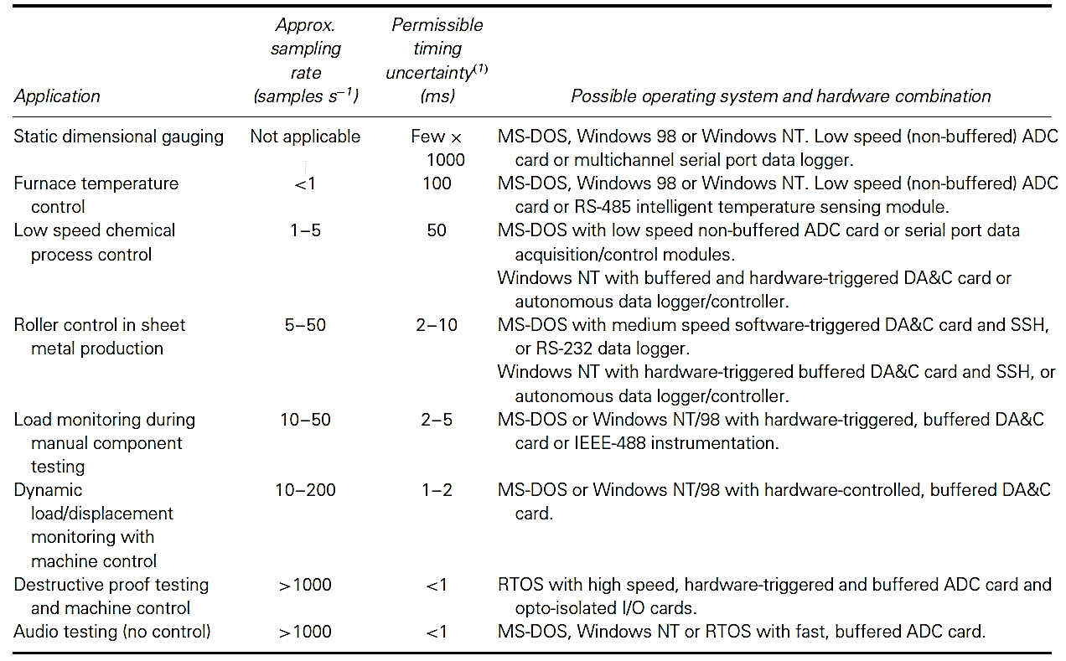
Non-deterministic OS and RTOs
DA&C applications representative of various timing regimes
© 2015 ELSIVER, All rights reserved. compiled by Dr. Osama Hosameldeen

Slide 25
BOIS
BIOS (basic input/output system) also manages data flow between the computer's operating system (OS) and attached devices, such as the hard disk, video adapter, keyboard, mouse and printer.
BIOS can be a source of problems in real-time applications.
Several of the BIOS services can suspend interrupts for unpredictable lengths of time. Some of the BIOS may also be non-re-entrant
© 2015 ELSIVER, All rights reserved. compiled by Dr. Osama Hosameldeen

Slide 26
DOS
Works in real mode. non-re-entrant, and it does not possess multitasking capabilities.
Nevertheless, it is inexpensive and is often suitable as the basis for simple DA&C systems
Real-time DOS systems are fully deterministic, having well-defined interrupt latencies, and are generally characterized by their ability to execute multiple processes using pre-emptive task scheduling
© 2015 ELSIVER, All rights reserved. compiled by Dr. Osama Hosameldeen

Slide 27
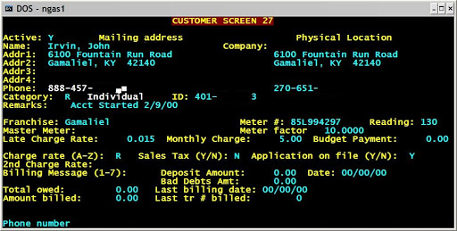
DOS
Control systems in factories always done with DOS.
A typical DOS based application interface screen is shown in the figure
© 2015 ELSIVER, All rights reserved. compiled by Dr. Osama Hosameldeen

Slide 28
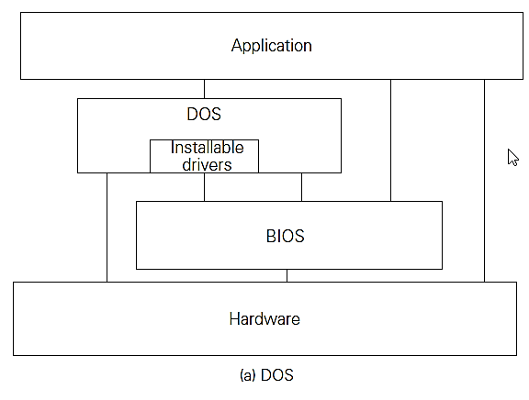
DOS and BOIS
© 2015 ELSIVER, All rights reserved. compiled by Dr. Osama Hosameldeen

Slide 29
MS Windows
Programs running under Windows execute under the control and supervision of the operating system.
They have restricted access to memory, I/O ports and the interrupt subsystem.
Furthermore, they must execute concurrently with other processes and this can severely complicate the design of DA&C programs.
Windows virtualization allows it to completely isolate application programs from the hardware. This introduces additional overhead in working with real time systems
© 2015 ELSIVER, All rights reserved. compiled by Dr. Osama Hosameldeen

Slide 30
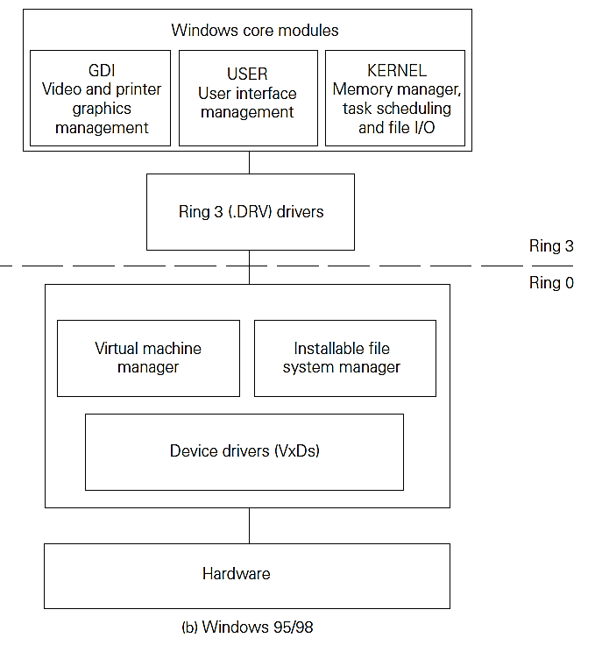
MS Windows
There are four privilege levels known as Rings 0, 1, 2 and 3.
Windows uses only two of these:
Ring 0 (also termed Kernel Mode under Windows NT) for highly privileged operating system routines and drivers; and
Ring 3 (also termed User Mode) for applications programs and some operating system code.

Slide 31
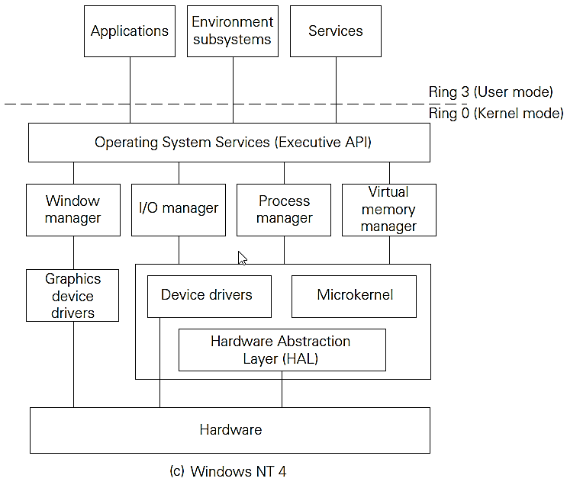
MS Windows
© 2015 ELSIVER, All rights reserved. compiled by Dr. Osama Hosameldeen

Slide 32
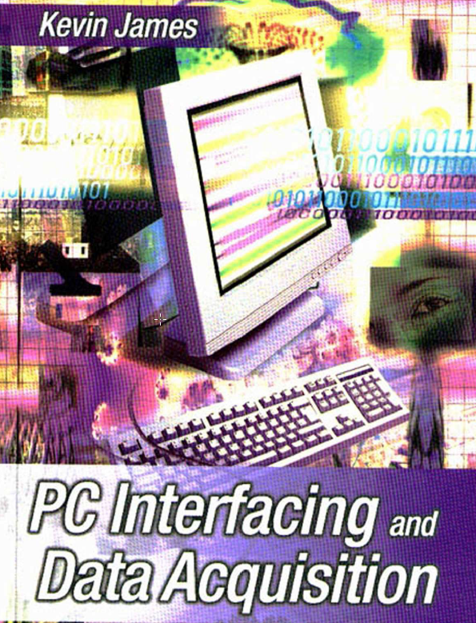
Reference
Kevin James - PC Interfacing and Data Acquisition Techniques for Measurement, Instrumentation and Control. (2000)

